Slide 1
Evaluation of communications and engagement activity to support NHS operational pressures
Pharmacy First 2024-25

Slide 2
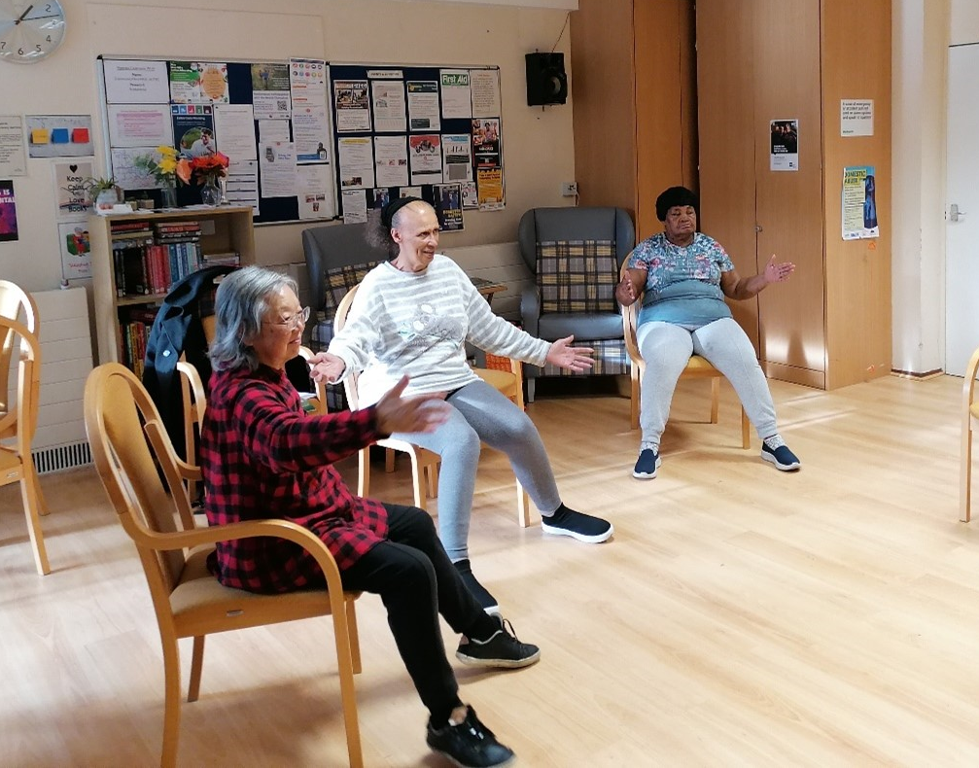
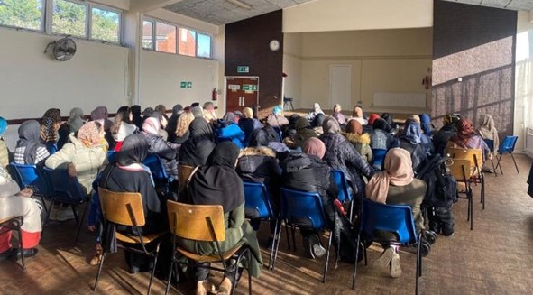
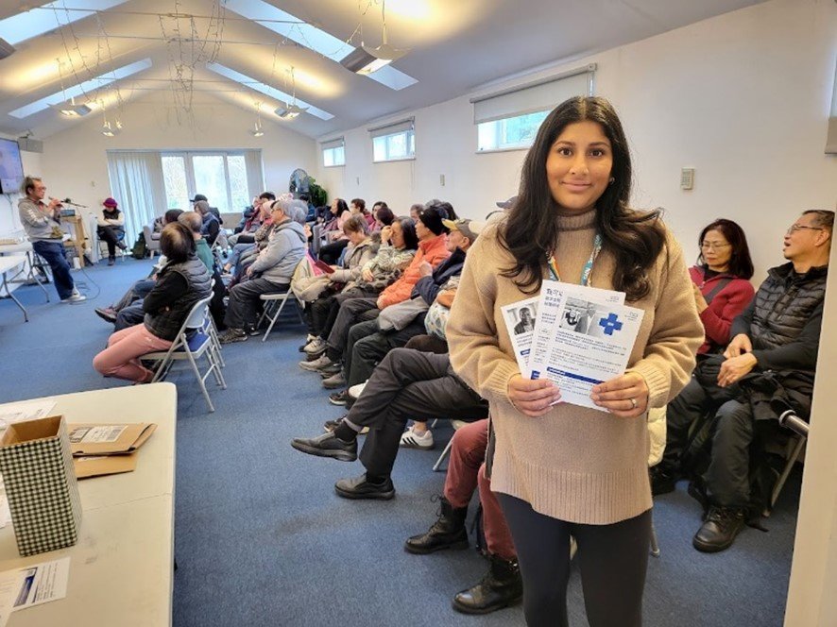
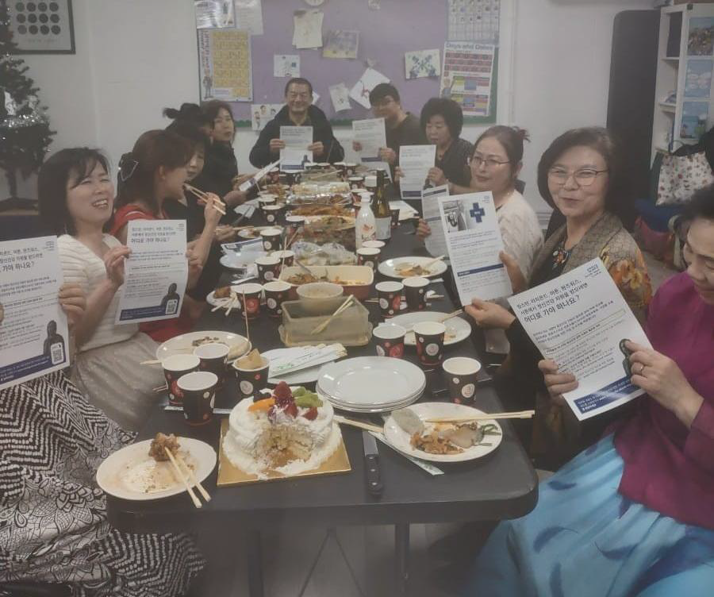
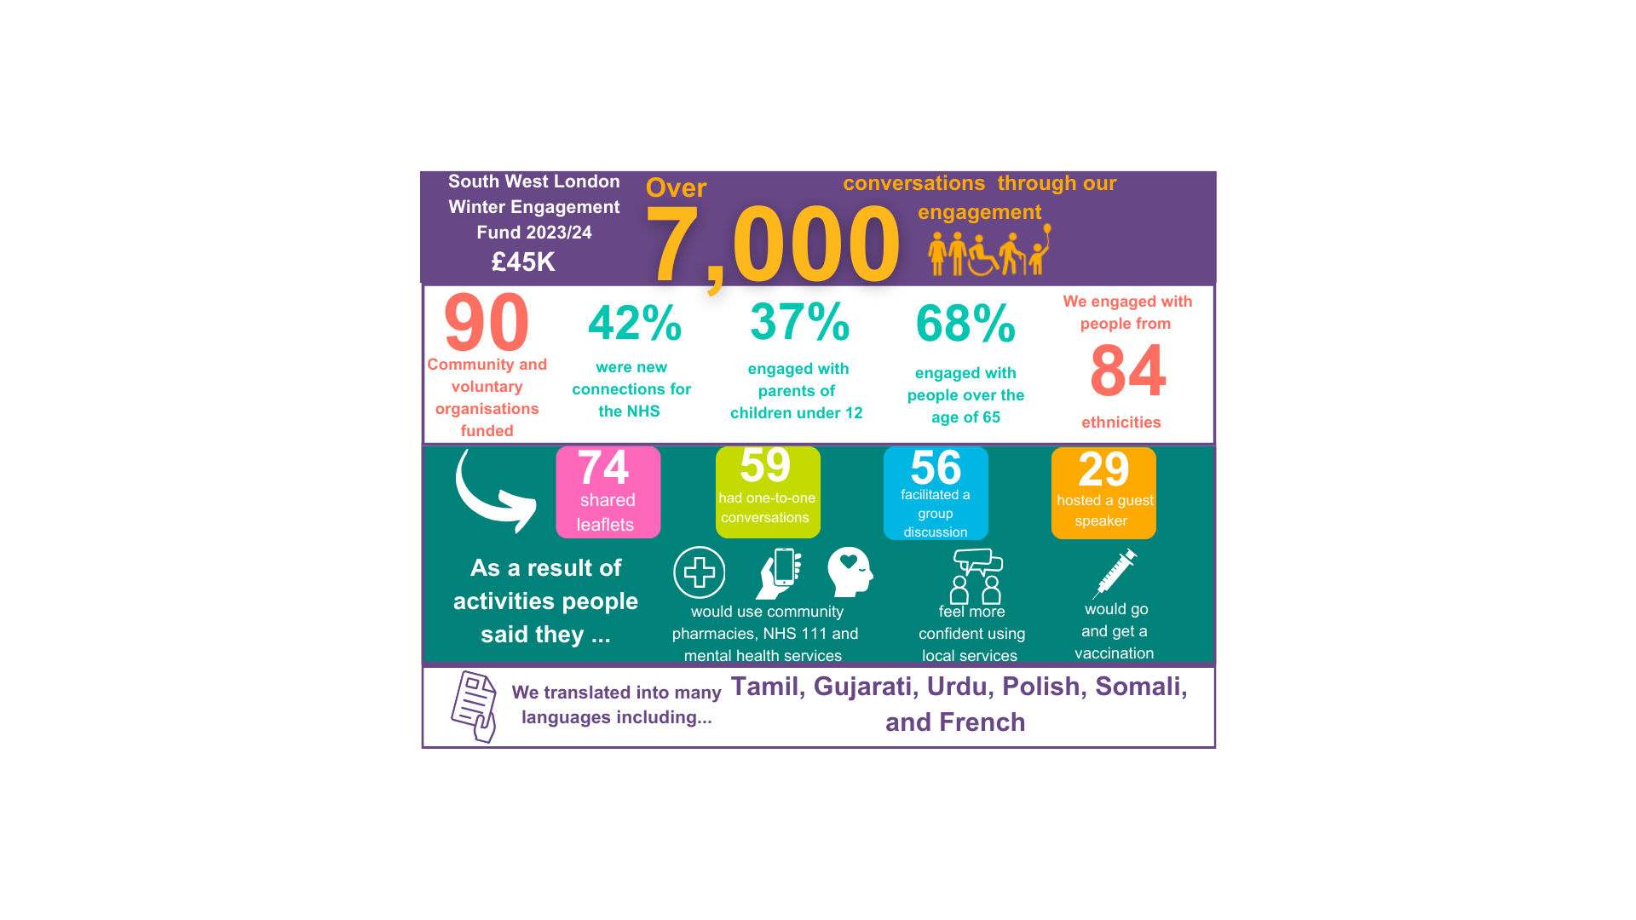
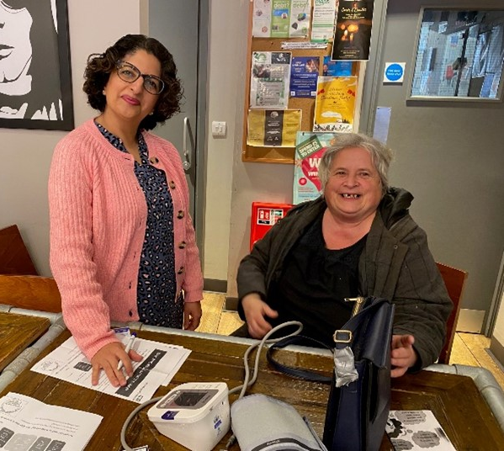
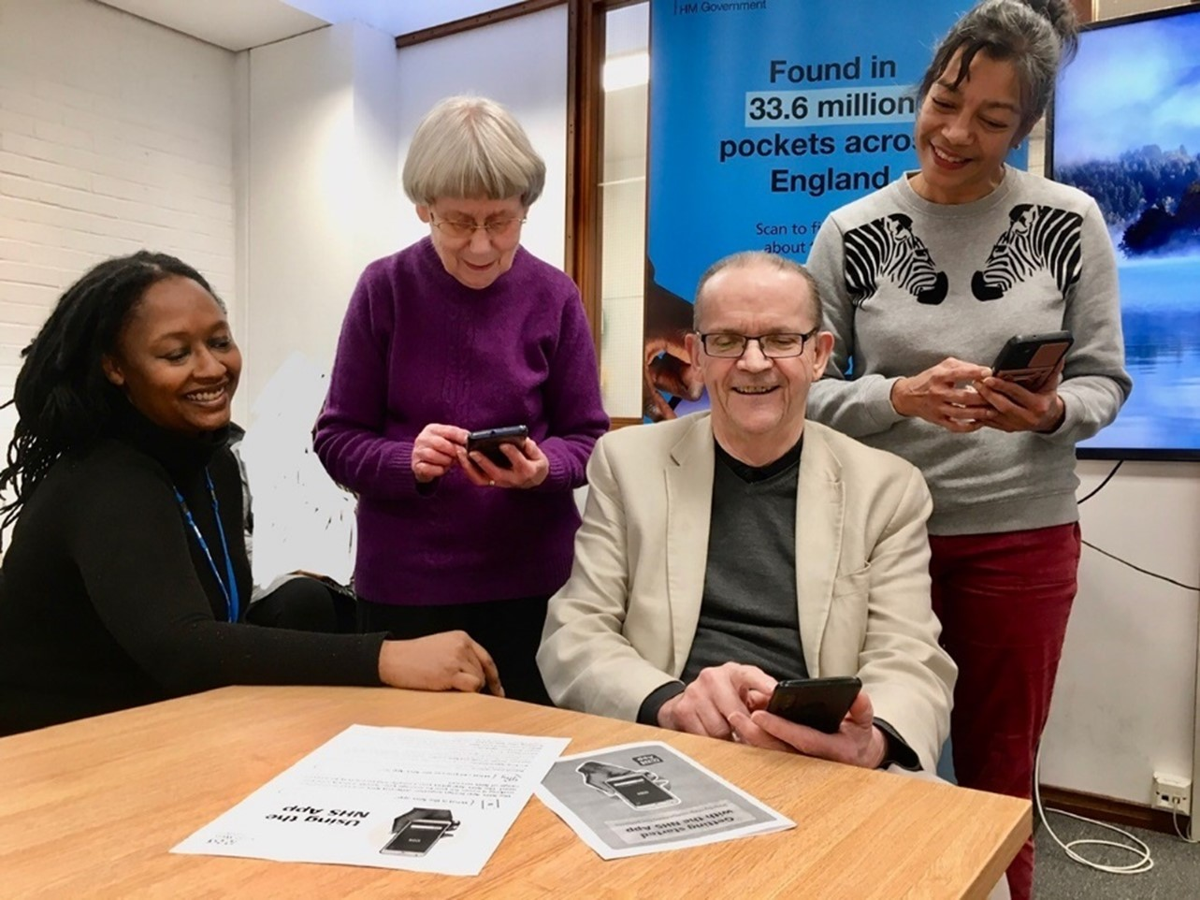
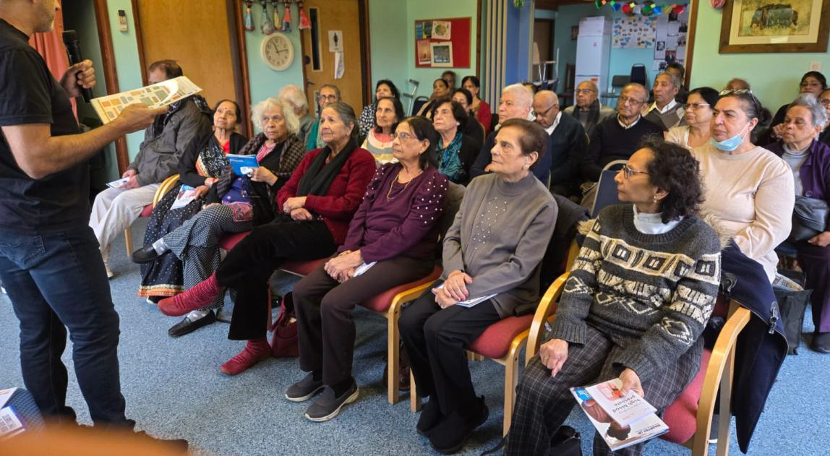
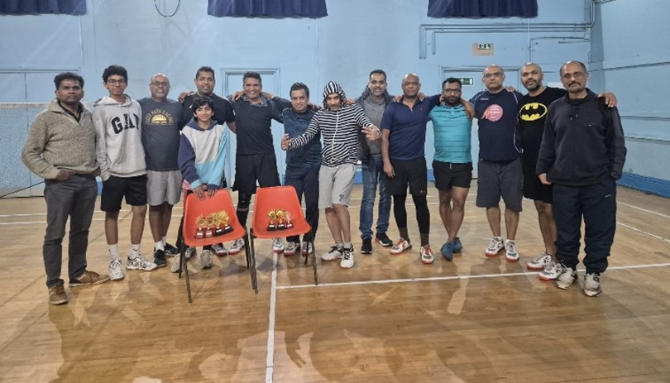
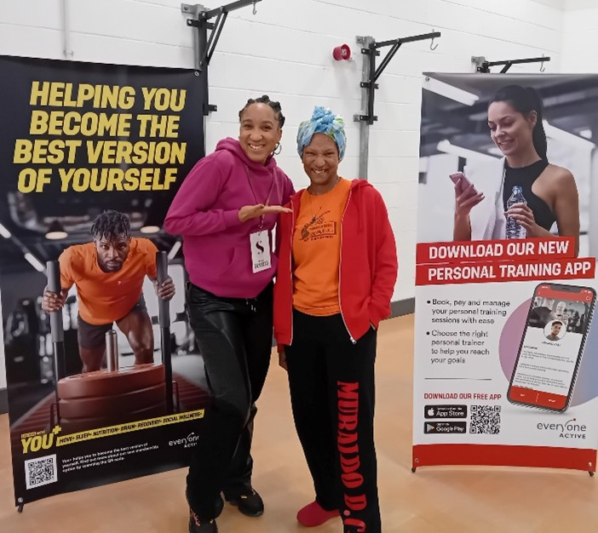
Conversations at the heart of our campaigns
Winter
Engagement
Fund 2024/25
10,000
conversations through our engagement
115
28%
45%
44%
64
community and voluntary organisations funded
More groups applied this year
engaged with people aged 18-65
engaged with people over the age of 65
We engaged with people from 64 ethnicities
854
shared
leaflets
65
had one-to-one conversations
63
had group discussions
26
had guest speakers
As a result of activities people said they…
Will share information with friends or family
Feel more confident using local health and care services
Would go and get a vaccination or visit a pharmacy
We translated information into many languages, including Urdu, Korean, Gujarati, Tamil, Polish, Spanish and Chinese

Slide 3
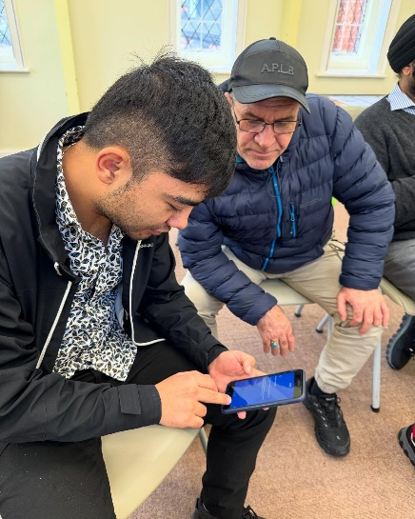
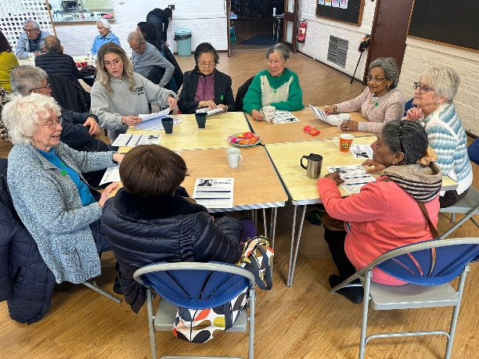
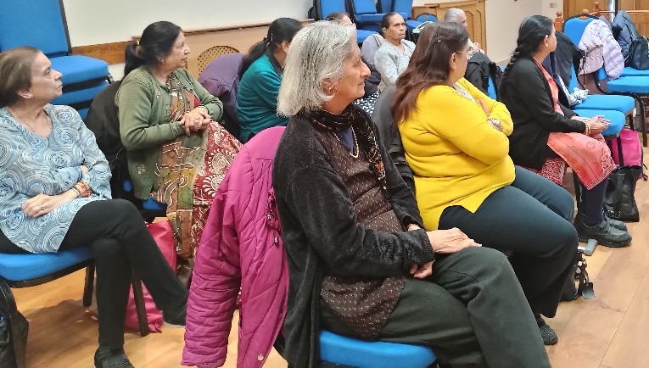
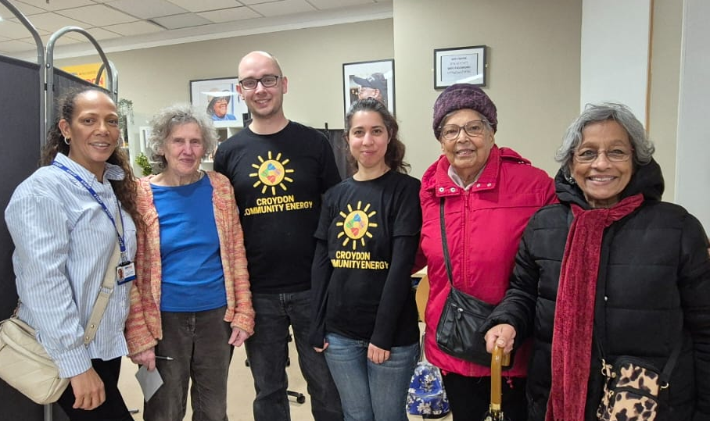
Feedback from winter engagement activities relevant to Pharmacies
Trust in pharmacy services, but with low understanding among some groups – there was a lot of positivity for local pharmacists amongst the communities we spoke to. General awareness of services continues to increase this year. However, knowledge could be very low where people hadn’t received information previously.
Challenges with language translation, interpretation and communication – this issue was raised frequently and was referenced as a critical barrier to seeking support and being able to engage well with services.
Unheard and not respected – a range of feedback relayed these types of sentiments with some saying they felt “let down by NHS services”. We heard people could feel dismissed or not taken seriously by health care professionals and administrative staff.
Support for NHS and praise for kind staff – there were manypositive comments by people about their experiences and particularindividual members of staff who had been kind.
Digital-entry to services off-putting – while we heard lots of positive comments about the NHS app, there was a strong feedback theme that people found digital access to some services extremely challenging.

Slide 4
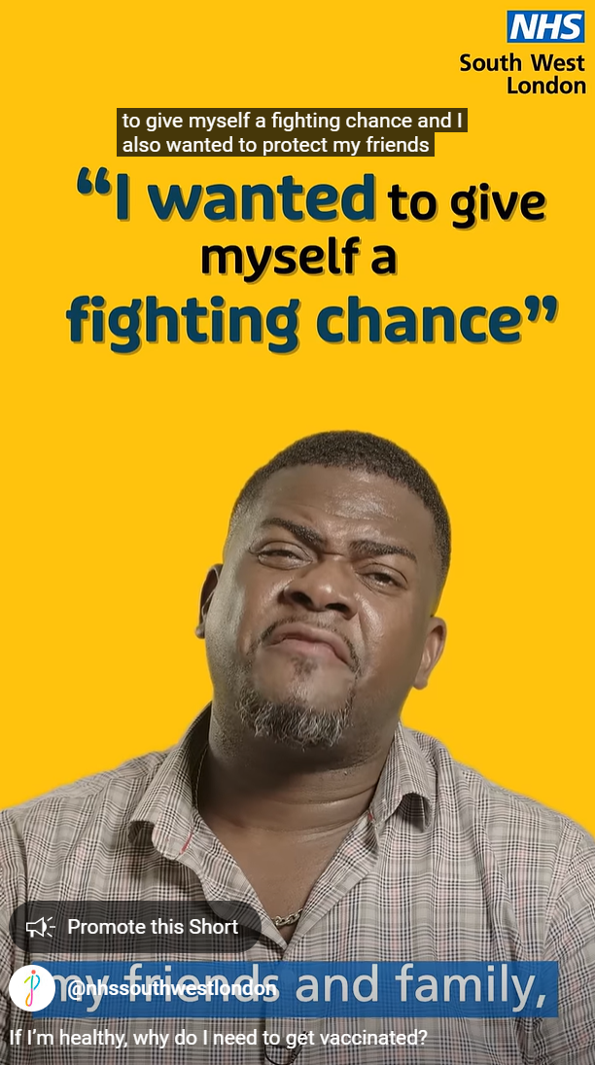
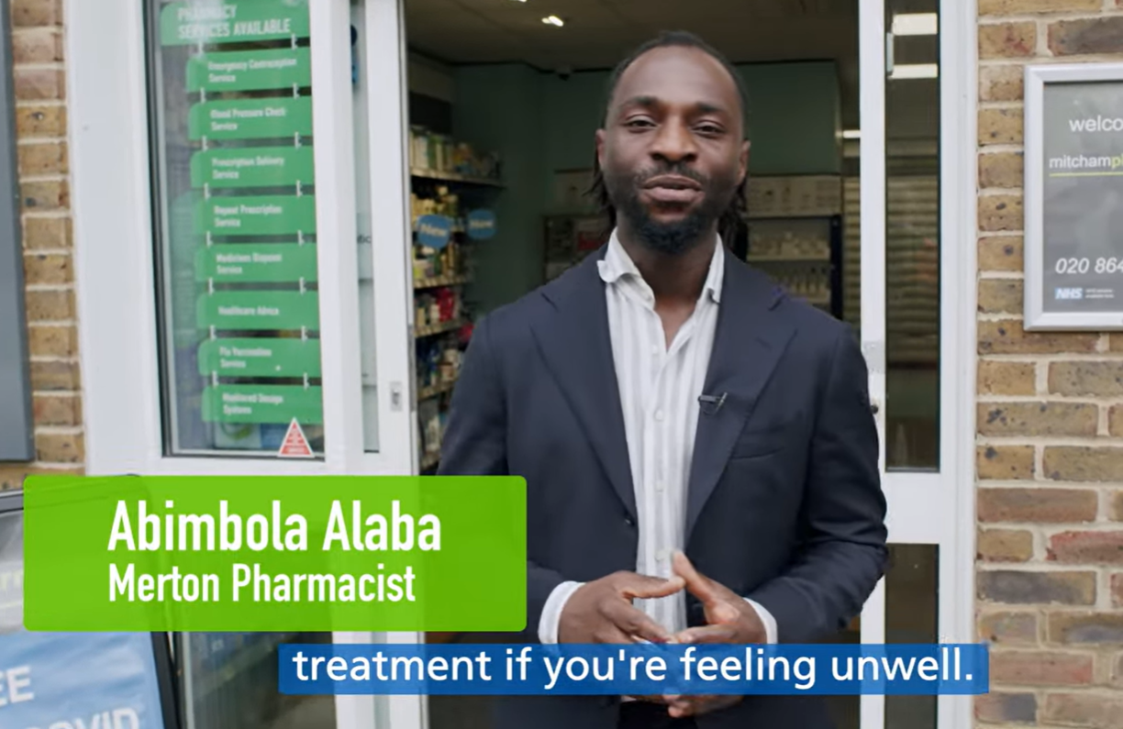
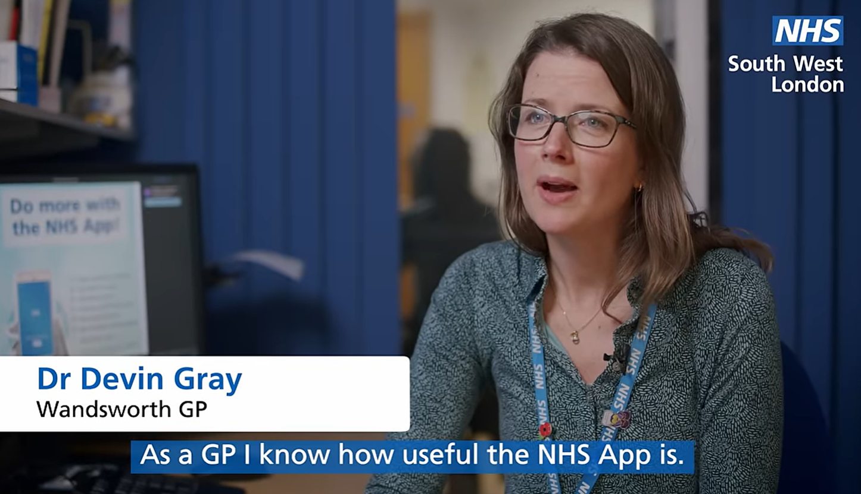
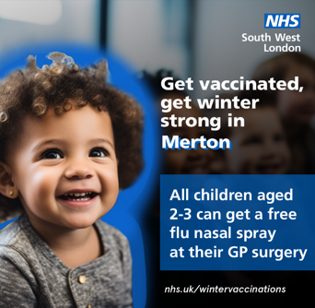
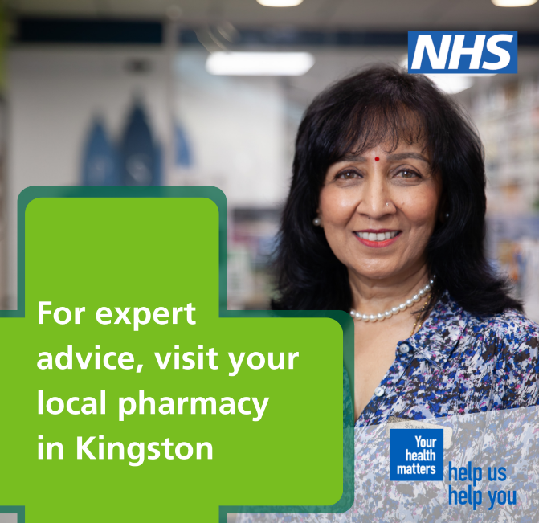
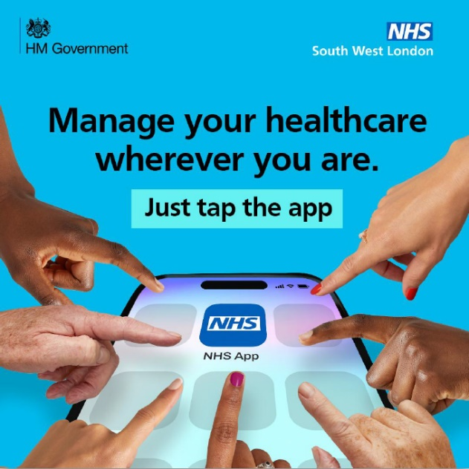
Priority campaigns October 24 – March 25
Vaccinations & imms
Pharmacy First
NHS app
Notes:
Largest range of channels used for this campaign - vaccination programme continues to invest in communications enabling us to ensure our messages continue to be seen
Continue to engage in low uptake areas – 11.46% of people that spoke to our community champions said they would get a vaccine as a result of the conversation
Local videos featuring local clinicians continue to drive up to 3 x the engagement of national materials on our channels

Slide 5
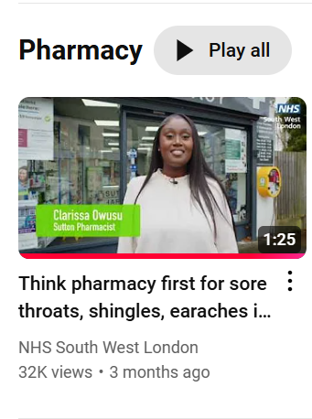
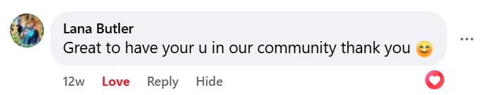
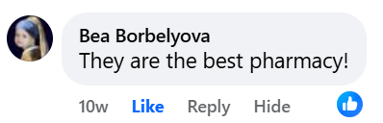
Key takeaways
Our most highly engaged with campaign - Our online only campaign was seen 3,928,034 times and generated 35,106 clicks (100% more than last year) – 1/3 of people who saw the campaign engaged with it. Our content was shared by NHSE London and local trusts.
Pharmacists are influencers – Our new, Pharmacy First videos got interaction rates of up to 48%. Individual pharmacists really capture people – particularly on Facebook - with engagement rates of up to 43%.
Pharmacists engaged – 53% of local pharmacists surveyed said they noticed an increase in patients during our campaign, 70% of pharmacists thought it was helpful and relevant. 37% said they saw an increase in the number of patients seeking advice or treatment in a language other than English.
Genuine interactions - People actually responded with comments in Tamil to our video featuring a pharmacist speaking in Tamil. If individuals recognise their local pharmacist sometimes they comment to say so.
There is work to do – awareness levels of pharmacy services can be low, particularly among HIE groups, however sentiment towards pharmacists is high. Pharmacists felt the campaign could have benefited from further publicity.
Notes:
Increased overall engagement rates with the campaign from 1.24% to 2.74% despite reduced budgets - started the campaign earlier in the season, and used videos in different languages.
For 3 years we ran footfall tracking to establish an indication of the effectiveness of our campaign - previous analysis shows people are up to 4 x more likely to visit a pharmacy after seeing one of our adverts.
Still more work to do - individuals in Core 20+5 areas told us that they didn't know about the extent of things pharmacies could offer before talking to us.

Slide 6
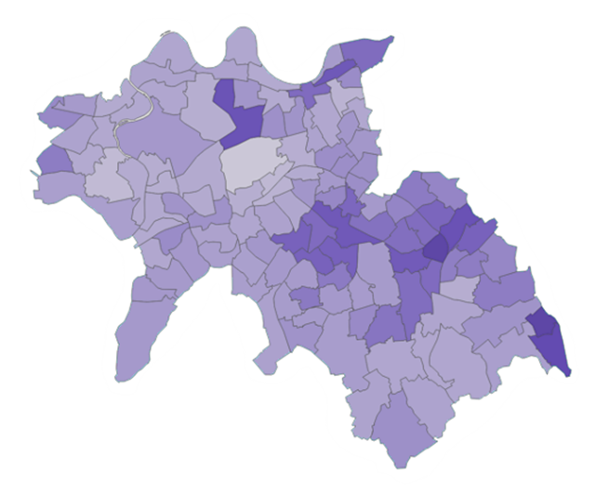
Engaging using translations in digital
Communicating with residents in their main language
17% of our population’s main language is not English, 2% cannot speak English very well or at all according to Census data.
High engagement rates for translated materials – engaged with over 87,273 times during our winter campaign period.
Community feedback - community organisations tell us this work is highly valued and makes communities feel "seen“, and builds trust.
Digital insight – comments on our social media channels are positive about the information being provided in different languages with some people commenting in different languages.
Vaccination materials in Urdu – best performing translated video advert on Youtube this winter. Highest views in Croydon, with highest clicks in Morden and Mitcham.
Promoting the childhood flu vaccination in Tamil – most highly engaged with in Mitcham, Pollards Hill and New Malden. Most viewed in Merton.
Promoting Pharmacy First in Arabic – engaged with in Addington, Wallington, Mitcham and Colliers Wood.
Top 5 non-English languages in South West London:
Tamil, Urdu, Gujarati, Polish and French
Notes:
Communicating with 17% of residents in their main language - across our 6 boroughs for up to 17% of the population, English is not their main language and up to 3% cannot speak English at all. (Census 2021).
Translation for community outreach - we translate materials into the most appropriate language for the activity we're carrying out – we have used X different languages over the past few years. We also use materials in British Sign Language.
Digital campaigns – based on an initial pilot, we now use translations for digital communications as part of the majority of our campaigns. Campaign spokespeople speak in different languages in videos and voicenotes, English videos include translated subtitles and text in images is translated.
How we share digital translations - digital content in the top five non-English languages across South West London is shared via WhatsApp, YouTube and other social media channels. We're able to targeting communities we know are interested based on our pilot work.
High engagement rates online - most recently translated materials have been seen over 3,000 times per day over a 4 week period. We also know people are more likely to engage with the content for longer than average – showing they're often watching or listening for the full duration.
Community feedback - we receive feedback from community organisations that this work is highly valued and makes certain communities feel "seen".
Notes
It’s worth saying that we are continually testing and refining our approach (i.e. that we know we can still work at improving what we’re doing!) – we know from national research that some languages are more popular orally than in written format hence the voice notes. BUT, we have trialled written subtitles on our english videos and have found good engagement here too. Community pharmacists are an amazing resource in terms of speakers of different langs and we’ve leant into this.
Through our digital channels we are building up an even greater understanding of which languages communities engage with most – this is layered with census data, and insights from community groups
Also – in case it comes up as there was some media recently about this in healthcare settings – we are committed to ensuring that we provide valid and trusted translations. We use a professional translation agency, as well as testing materials with local voluntary sector organisations and groups for feedback.

