Slide 1
Community Pharmacy Assurance Framework Screening Questionnaire
July 2024

Slide 2
Acknowledgements
My thanks to James Wood and Katrina at Community Pharmacy England.
CPAF (Community Pharmacy Assurance Framework)

Slide 3
Agenda
No. | Section | Lead | Timing
1. | Welcome & Introductions | David Tamby Rajah | 8.00-8.05
2. | CPAF Introduction | David Tamby Rajah | 8.05-8.10
3. | CPAF 10 questions | David Tamby Rajah | 8.10-8.30
4. | Your feedback CP challenges and best practice sharing | Open | 8.30-8.40
5. | top tips and hints |  | 8.40-8.50
6. | AOB & Next steps | All | 8.50-9.00

Slide 4
Community Pharmacy assurance framework
NHS England /delegated ICBs monitor the provision of essential and advanced services using the CPAF with the terms of CPCF. Pharmacies must complete the CPAF every year. This is a demonstration of compliance with the community pharmacy contract.
The process
The Community Pharmacy Assurance Framework (CPAF)started on June 2024 and will finish at the end of March 2025.
There are 2 sections
10 CPAF screening questions (all Pharmacies to complete) July 1st – 31st .
Visits? –September 2024 – Mid October 2024 to be confirmed.
Full CPAF questionnaire (pharmacies identified to complete 1-3% of all London Community Pharmacies)
Full visits?? -possible dates Jan 2025– March 2025 ?? to be confirmed.
CPAF is managed via NHSBSA portal.
Information collected from this questionnaire helps to identify whether a visit is needed.
Please contact pharmacysupport@nhsbsa.nhs.uk regarding CPAF.
Community Pharmacy Assurance Framework (CPAF )- NHSBSA

Slide 5
CPAF screening
The 2024/25 Screening Questions will be available for completion between 1st July 2024 and midnight on 31st July 2024.
The short screening questionnaire consists of 10 questions. Pharmacy owners who use the NHSBSA Manage Your Service (MYS) portal will be required to complete the questionnaire on the portal.
The questions will be published on the NHSBSA website ahead of the 1st July 2024 go-live date to give pharmacy owners advance notice of these.
Community pharmacies should receive information and instructions on how to complete the screening questionnaire either via email from the NHSBSA or from their own Head Office.
If you have not received details of the questionnaire by 2nd July 2024, or if they have any problems or queries completing the questionnaire. Pharmacy owners are advised to contact NHSBSA emailing pharmacysupport@nhsbsa.nhs.uk

Slide 6
Why this questionnaire is important?
It is a requirement of the Terms of Service.
It is likely to mean avoiding unnecessary monitoring visits and action plans,
Demonstrates compliance with the Terms of Service by the pharmacy.
Non-compliance with CPAF i.e. not assured could result prevention of delivering advanced services i.e. Pharmacy First , NMS

Slide 7
CPAF levels. (1-3)
The expectation is that Level 1 and 2 are attained for each question to indicate compliance with the Terms of Service.
Level 3 demonstrate exemplary practice and is a level to which members should aspire.
The levels are interdependent - The community pharmacy must accurately state the level the pharmacy is working to.
Attainment Level Checklist
Please tick the boxes to show which criteria your pharmacy meets.
To attain Level 1 you must select all Level 1 criteria
To attain Level 2 you must select all Level 1 and all Level 2 criteria
To attain Level 3 you must select all Level 1 and all Level 2 criteria and select at least one of the Level 3 criteria (if more than one option is available)

Slide 8
The 10 questions
Question 1: Standard Operating Procedures (SOPs) RETIRED
Question 2: Prescribed Medicines Advice RETIRED
Question 3: Storage of Prescribed Drugs and Return of Unwanted Medicines
Question 4: Repeat Dispensing
Question 5 Owings RETIRED
Question 6: Prescription Based Interventions
Question 7: Signposting
Question 8: Clinical Governance - Risk Management
Question 9: Clinical Governance – Locums RETIRED
Question 10: Training & Performance Management RETIRED
Question 11: Safeguarding
Question 12: Pharmacy Based Audit RETIRED
Question 13: The promotion of healthy living
Question 14: The pharmacy premises and privacy
Question 15: Community Pharmacy Staffing
Question 16: Opening Hours, Temporary & Emergency Closures

Slide 9
Monitoring of SOPs
The Essential service specifications require the pharmacy to have appropriate SOPs for dispensing, RD and support for self-care.
Monitoring compliance is the determination of whether the pharmacy has an appropriate SOP. It does not require NHS England to carry out a detailed analysis of the content of the SOPs. Indeed, it would be unwise for NHS England to carry out any detailed examination, because it will be unable to determine what is appropriate for the individual pharmacy concerned, and any shortcomings not identified, or suggestions made which themselves cause problems in delivery of the services, could lead to NHS England itself being involved in litigation.
The most appropriate way for NHS England to determine whether the pharmacy has an appropriate SOP is to ask to see it during a monitoring visit (but without reading it in detail), then to ask appropriate members of staff suitable questions about their procedures to establish the level of understanding and compliance with the SOP.

Slide 10
Recording advice and interventions
Refer to the word attachment Recording advice, interventions and referrals in community pharmacies
As part of the NHS Terms of Service for community pharmacies in England, there are various requirements for pharmacies to keep records of advice, interventions and referrals.
This applies to dispensing, repeat dispensing , public health sign posting and self care .
What is the reason for keeping the records?
The Terms of Service require records to be kept ‘where appropriate’ or when ‘clinically significant’. The record will be of no value if it is made just for the sake of making it – it must be linked to improving patient care, maintaining high quality service from the pharmacy or in some cases managing risk. E,g:
the pharmacy to ensure that there is continuity of care e.g. a particular brand of medicine is supplied for a patient, allergies to particular excipients, medication is supplied with larger label fonts or in specific containers etc;
other pharmacists and staff to understand what you discussed with a patient at the time, if you are not working in the pharmacy the next time the patient comes in to the pharmacy; and
you to follow up on advice given or treatment recommended to enhance patient care particularly if you would want to double check that a patient had taken on board important advice.

Slide 11
NHS Approved Particulars
NHS England publishes approved particulars relating to the National Health Service (Pharmaceutical and Local Pharmaceutical Services) Regulations 2013, as amended. These approved particulars are available below. The date each requirement takes effect is set out in each approved particular.
Approved particulars - community pharmacy: notification of a temporary suspension or a likely temporary suspension
Approved particulars - community pharmacy: displaying notices regarding a temporary suspension
Approved particulars - Information Governance Programme
Approved particulars - pharmacy practice leaflet
Approved Particulars - premises
https://cpe.org.uk/our-news/updated-incident-reporting-approved-particulars/

Slide 12
Incident Reporting
The clinical governance requirements of the CPCF include an approved incident reporting system, together with arrangements for analysing and responding to critical incidents.
The updated Incident Reporting Approved Particulars confirm existing expectations and practice, Pharmacies must have a patient safety incident log for all incidents, which captures the information set out in the Approved Particulars.
Pharmacies must report to the Learn from Patient Safety Events Service (LFPSE) relevant incidents (but not near misses) and when reporting use the defined levels of physical and psychological harm grades in LFPSE.
Pharmacies must notify a referring external organisation of the incident with appropriate details, where the incident is related to a referral from that organisation,
Only relevant staff providing NHS services should be involved in patient incident analysis.
The pharmacy owner must participate in any reasonable activities associated with patient safety incidents including engaging in review and root cause analysis where requested to do so by the relevant service commissioner, or other referring organisation where the incident is related to a referral from them.
Pharmacies may report incidents anonymously if, e.g. the error could constitute a criminal offence, or as part of staff ‘whistleblowing’ in relation to unsafe dispensing practices.

Slide 13
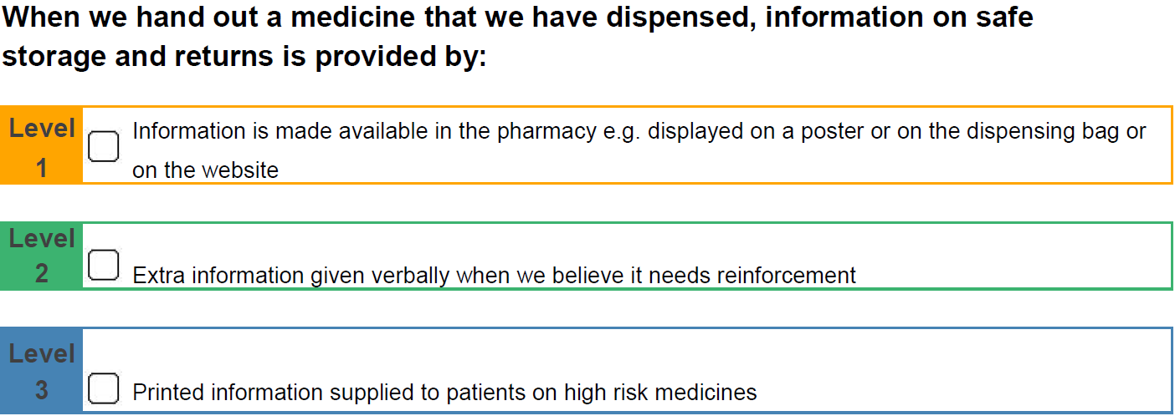
Question 3: Storage of Prescribed Drugs and Return of Unwanted Medicines
Your Waste managing agent is Essentia for S. London. (see the S. London LPC waste FAQ)
Level 2 ideally the pharmacy should give an example of how they would advise safe storage of medicine at home
i.e. to store your medicine in an area that is convenient but is also cool and dry – heat and humidity can damage medicines.
Keep secure – out of the reach of children
Keep refrigerated v i.e. vaccines, insulin
Community Pharmacy England Disposal of Unwanted waste

Slide 14
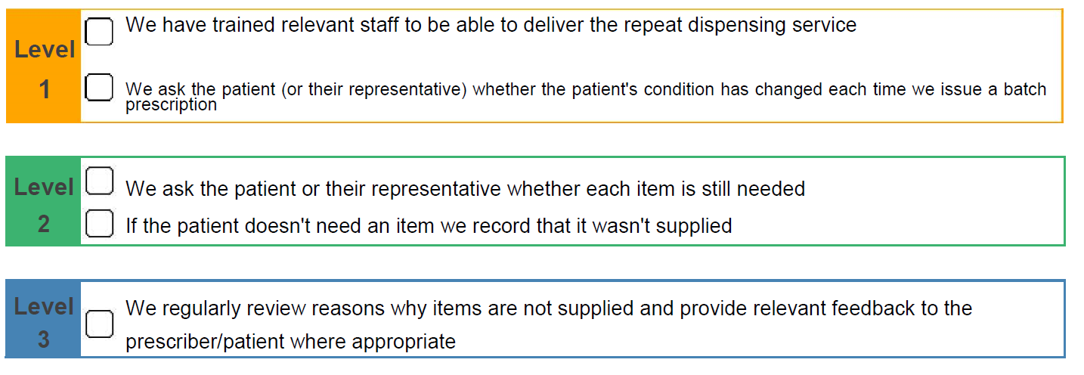
Question 4: Repeat Dispensing
Terms of Service relating to repeat dispensing require pharmacies to keep and maintain records of clinically significant interventions in cases involving repeatable prescriptions.
the pharmacy has notified the prescriber that a supply of medicines or appliances have been refused.
the patient is referred back to prescriber for further advice if supply of medicines or appliances has been refused;
the pharmacy notifies the prescriber of any clinically significant issues arising in connection with the prescription. Further information and resources on repeat dispensing can be found on our Repeat dispensing page.
Community Pharmacy England RD and ERD

Slide 15
Question 4: Repeat Dispensing
Training may be provided in house by some of the larger pharmacies or through the Centre for Pharmacy Postgraduate Education (CPPE)
Repeat dispensing (RD) means 'batch prescriptions', i.e. NHS repeatable prescriptions.
Uptake of NHS RD varies across GP practices- Feedback what the level of RD uptake is with Local GPs .
The pharmacist and team should be able to state what required to be done for if an RD prescription is presented irrespective of the uptake in the local area. Do your staff understand the process ?
RD is not the same as repeat ordering.
https://www.psnc.org.uk/wp-content/uploads/2013/07/service20spec20es22020repeat20dispensing20_v1201020oct2004_.pdf
https://cpe.org.uk/national-pharmacy-services/essential-services/repeat-dispensing/

Slide 16
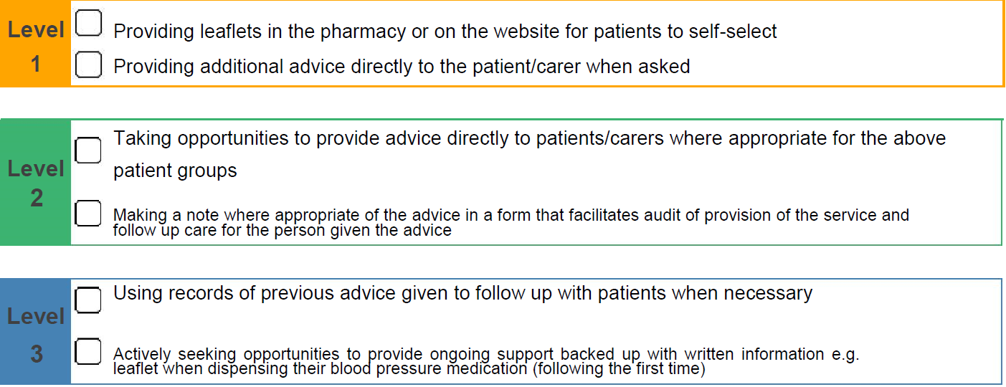
Question 6: Prescription Based Interventions
When appropriate we provide advice to people presenting prescriptions who :
have diabetes
are at risk of CHD (especially those with high blood pressure)
smoke or are overweight
The aim of increasing the person's knowledge and understanding of the health
issues which are relevant to that person's personal circumstances by:
This is to show the value Community Pharmacy increasing patient’s the person's knowledge and understanding of the health issues i.e. LTC’s -leaflet stands,
Community Pharmacy England Public Health lifestyles

Slide 17
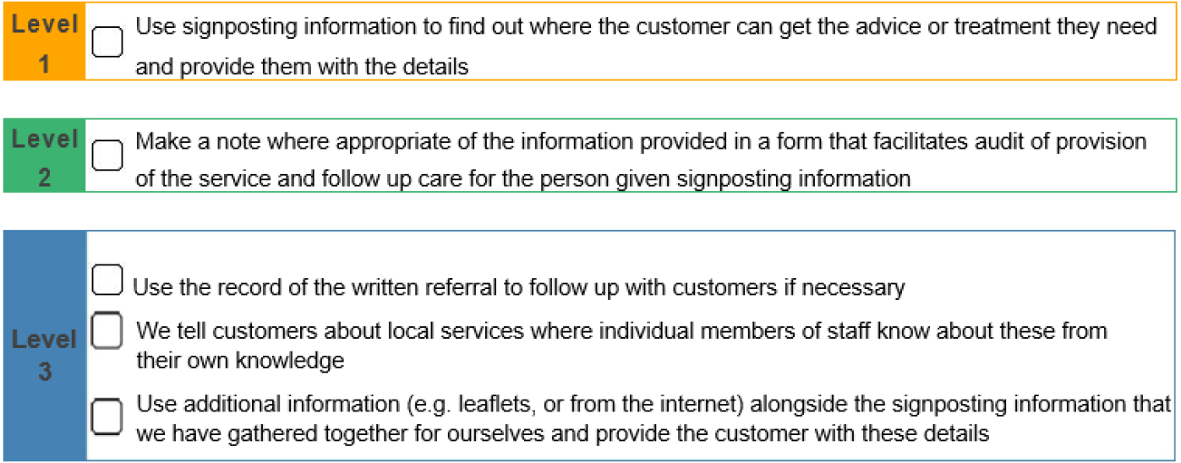
Question 7: Signposting
Community pharmacies play a major role signposting patients to health & social care.
NHS England advised that NHS website, NHS E. ICS and Local authority websites should be used.
Highlight the important contribution Community Pharmacies can make to this area.
(The former PCT signposting folders are out of date ).
Community Pharmacy England – Signposting

Slide 18
Question 7: Signposting (not exhaustive )
SW London ICS
SW London Places
SW London ICS – find services
Croydon Council – Health & Wellbeing
Kingston Council –Health & Wellbeing
Richmond Council – Public Health
Merton Council- Better Health
Sutton Council Health
Wandsworth Local Authority Public Health
NHS website,
Asthma & Lung UK
Diabetes UK
Epilepsy Society
Macmillan Cancer Support
British Heart Foundation

Slide 19
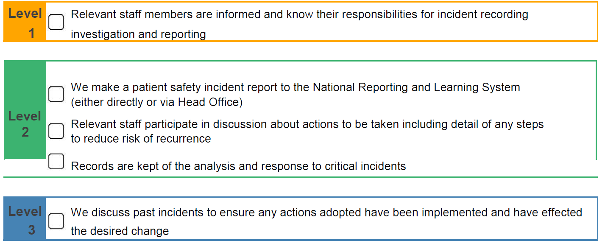
Question 8: Clinical Governance - Risk Management
NHS approved particulars associated with clinical governance requirements for community pharmacies -IG, practice leaflet, patient satisfaction survey and premises. https://www.england.nhs.uk/publication/approved-particulars/
The Pharmacist must demonstrate what happens when a patient safety incidents occurs in the pharmacy i.e. reporting , team learning , root cause analysis. Stresses the importance of assurance, and the measure of a good pharmacy - analyses and learns from an incidents.
Community Pharmacy England –Clinical Governance

Slide 20
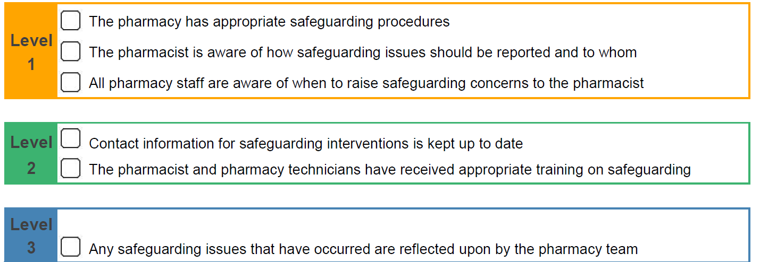
Question 11: Safeguarding
Safeguarding for children, young people and adults at risk . (Level 2/3)
Safeguarding is a key standard for national locally commissioned services (sexual health , drug misuse, smoking cessation) .
Safeguarding is everyone’s responsibility. Stress the importance of knowing what to do if there are any signs of safeguarding concerns.
Download the NHS safeguarding app – make sure your whole team are aware of this

Slide 21
Question 11: Safeguarding
To achieve Level 2 (minimum) for CPAF you are required to declare that the pharmacist and pharmacy technicians have undertaken or renewed training on Safeguarding in the last 2 years. Some services (ie PCS) require Level 3 safeguarding. Suggested Actions Check the dates of your most recent training-it is dated in the last two. years If your training is out of date act now to renew before the end of the month, so you can complete your CPAF by the deadline of the 31st July 2024 – it is estimated that this training will take around 2.5 hours to complete Resources Safeguarding training is linked from the CPPE website Local safeguarding information is available on the NHS safeguarding app or Local authority websites GPHC – safeguarding (acknowledgements Greater Manchester LPC)

Slide 22
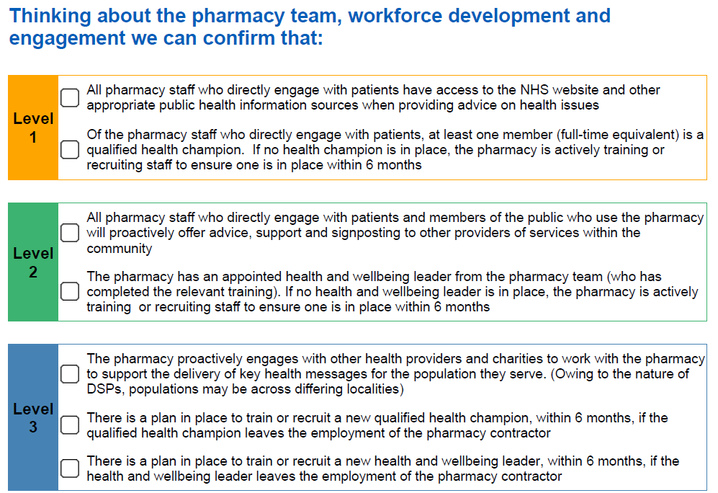
Question 13: The promotion of healthy living

Slide 23
Question 13: The promotion of healthy living
The Healthy Living Pharmacy (HLP) framework is aimed at achieving consistent provision of a broad range of health promotion interventions through community pharmacies to meet local need, improving the health and wellbeing of the local population and helping to reduce health inequalities
From 1st January 2021, all pharmacies (including DSPs) had to meet the HLP requirements which are detailed in the NHSE&I regulations guidance, although most pharmacies in England had previously met the HLP Level 1 requirements, following local initiatives with commissioners or the PQS.
To ensure contractors continue to meet their Terms of Service requirements, it is recommended they review their compliance against the requirements every three years. CPE guidance and a range of resources to help contractors become and maintain HLP requirements can be found on here
Click on a heading below for more information.
Introduction and background information
How to become an HLP or maintain that status
Guidance and resources
Frequently Asked Questions
/

Slide 24
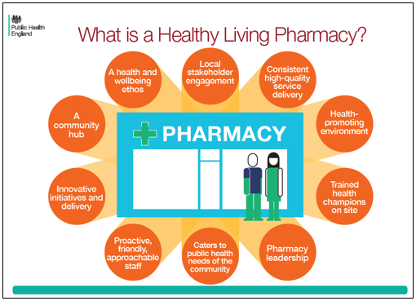
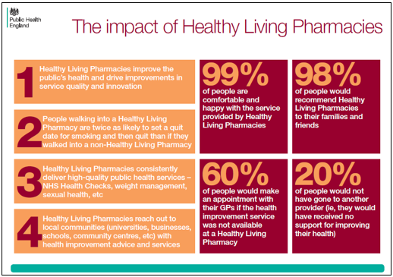
Question 13: The promotion of healthy living
HLP status
Workforce Development
Engagement
Premises Requirements
Health Living Ideas
Antibiotic resistance
Alcohol
Cancer
Diabetes
Flu
Healthy eating and obesity
Men’s health
Mental health and wellbeing
Oral health
Physical activity
Self-care
Sexual health
Smoking
Substance misuse

Slide 25
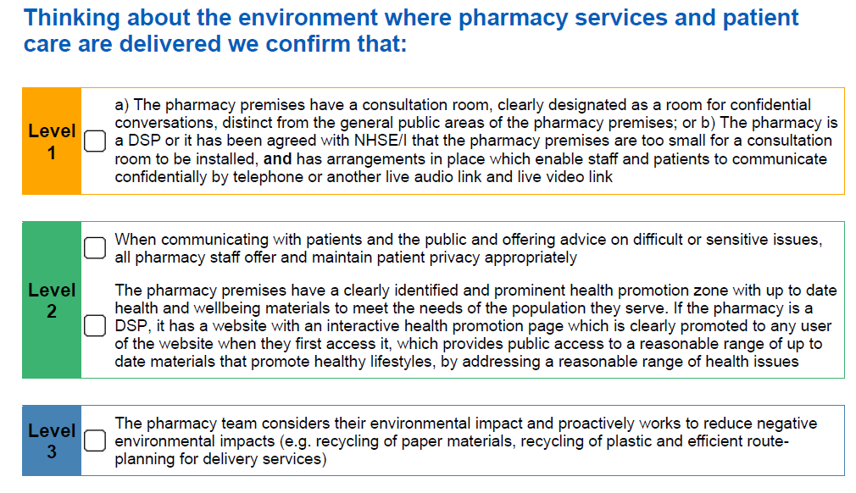
Question 14: The pharmacy premises and privacy

Slide 26
Question 14: The pharmacy premises and privacy
Consultation room requirements Information on the Terms of Service requirements for a consultation room can be found in the Regs Reminder on consultation rooms and remote consultations. There are alternative requirements for some pharmacies, for example, DSPs, and in a small number of cases exemptions apply which may be time limited.
The requirement for the consultation room is based on the existing requirement for a consultation room which is included in the service specifications of most of the Advanced services; most pharmacies already comply with these requirements.
The requirements for the consultation room are that it is:
clearly designated as a room for confidential conversations, for example a sign is attached to the door to the room saying Consultation room;
distinct from the general public areas of the pharmacy premises;
a room where both the person receiving the service and the person providing it can be seated together and communicate confidentially.
Approved Particulars - premises

Slide 27
Question 15: Community Pharmacy Staffing

Slide 28
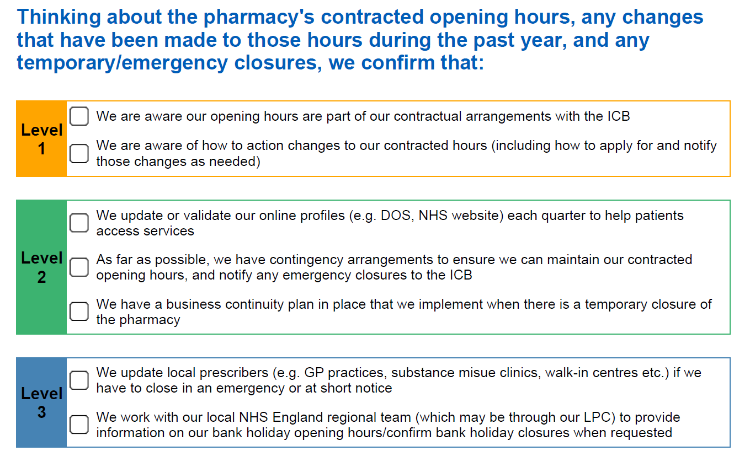
Question 16: Opening Hours, Temporary & Emergency Closures

Slide 29
Question 16: Opening Hours, Temporary & Emergency Closures
Briefing 011/22: Temporary closures of community pharmacies (Published on: 1st April 2022 | Updated on: 30th June 2022)
This Briefing provides information on temporary closures of community pharmacies due to illness or other reasonable cause – beyond the control of the contractor – from 1st April 2022.
PSNC Briefing 011/22: Temporary closures of community pharmacies
For more information on this topic please email regulations.team@cpe.org.uk

Slide 30
Top tips
Understand the annual CPAF process and timelines – put this in your diary
Start from the full CPAF questionnaire , then read the screening questionnaire.
Skill mix – raise awareness with your pharmacy team , build into objectives, job descriptions.
Read the NHS approved particulars and documents.
Recording advice and interventions covers dispensing, repeat dispensing , public health sign-posting and self-care .
Identify team champions – Clinical Governance , Healthy living
Save your screening questionnaire response and levels; look to increase to the next level over 12 months.
Submit on MYS with 2- 3 days to spare.
Address any gaps now, do not wait for a visit.
Ask for help - the LPC is here to help you!!!!!

