Slide 1
Hitesh Patel CEO Raj Matharu Chair

Slide 2
Business Continuity Plans
Loss of Main Pharmacy Building
Failure of Electricity Supply
Failure of Gas Supply
Failure of Water Supply
Failure of Telecommunications/Broadband
Failure of IT Systems
Failure of EPS
Fuel Shortages
Loss of Security
Staff Shortages
Mutual Aid Arrangements with Others
Disruption to Supplies
External Adverse Events

Slide 3
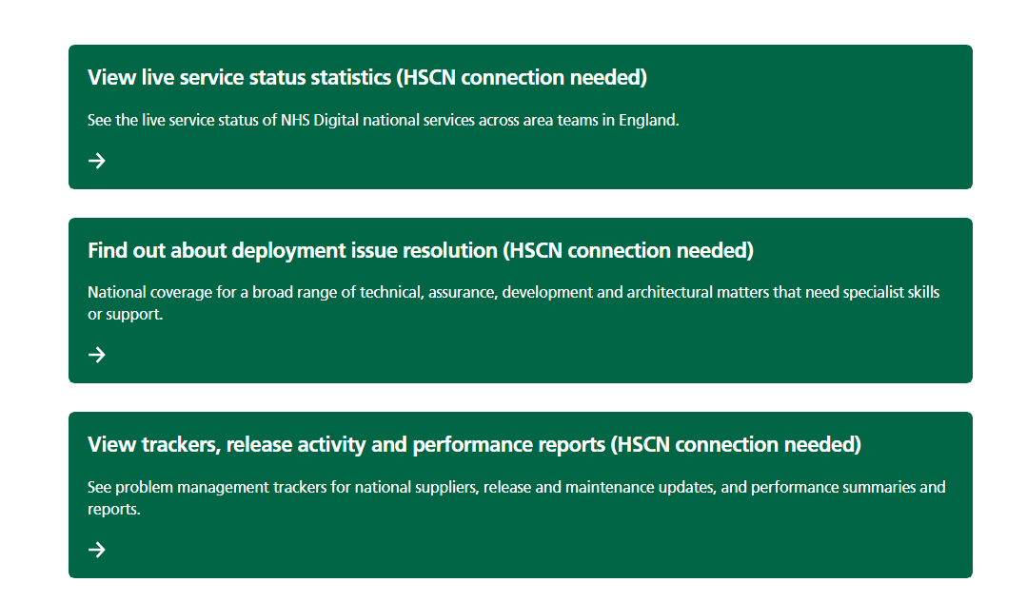
https://digital.nhs.uk/services/service-management

Slide 4
https://digital.nhs.uk/services/service-management
This means that a pharmacy team experiencing problems accessing or processing an electronic prescription can see at a glance if there is a national service issue. If it is not a national service issue, it is likely to be a problem with their PMR system or with their local equipment or internet connection. In this case, users can be confident that they should contact their supplier’s helpdesk for support.

Slide 5
Failure of Telecommunications/Broadband
Is your PMR supplier providing the N3 connection ( HSCN connection) ? What does their SLA state for fix time?
Almost CPs get their HSCN through the PMR providers
The HSCN is bundled with the PMR subs and almost impossible to get a separate HSCN
PMR suppliers will resist CPs getting their own HSCN citing ‘connectivity and support’ issues
CPs will go for cheapest PMR deal and ignore HSCN connection
considerations when buying a new system
If you are using your own to broadband what is the lead time for fixing it? Use the best broadband with quick lead times for fixing
HSCN will be replaced by CIS2 authentication

Slide 6
Failure of IT systems
Current problems with Sonar and Pharmoutcomes
Choice of PMR supplier. Is a PMR enough in the clinical future of community pharmacy? From 2026 with IPs coming out of universities you will need a prescribing system
The future is with Clinical + Client Relationship Management systems which incorporate clinical services. Prescription fulfilment, prescription management, clinical services, SCR, prescription tracker
Don’t get tied into long contracts

Slide 7
Failure of EPS
Patient to return to the pharmacy at a later time (if script not required immediately).
Deliver prescriptions to patient when systems are resumed.
Emergency supply at the request of the prescriber.
Paper FP10 prescriptions printed by arrangement with the GP surgery.
Referral to another pharmacy (not suitable for some scenarios).

Slide 8
Template for Business Continuity
Download from the CPE website
https://cpe.org.uk/quality-and-regulations/clinical-governance/emergency-planning/

Slide 9
Workforce, Training and Development
IP training
All CPs must become IPs
Pharmacy graduate from 2026 will come out as IPs
Fully funded IP courses available

Slide 10
Workforce, Training and Development
Community pharmacists and pharmacy technicians are being offered a range of fully-funded, flexible training to expand your clinical skills and improve patient care.
Click on the following links:
Community Pharmacists - Fully funded training
Community Pharmacy Technicians - Fully funded training
Courses currently include:
Clinical Examination Training Skills - Delivered by CliniSkills
Independent Prescribing - Delivered by approved education providers
Pharmacy Technicians: Advancing your role - Delivered by CPPE
Education Supervisor Training for Pharmacists and Pharmacy Technicians - Delivered by ProPharmace

